Slide 1
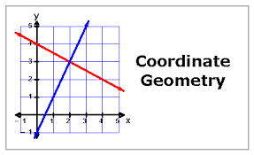

Slide 2
WHAT’S COORDINATE GEOMETRY
The coordinate geometry is an important branch of mathematics which mainly helps us to locate points in a plane. It’s uses are spread in all branches like trigonometry, calculus, dimensional geometry etc.
Along with many fields like architecture, mechanics, astronomy etc. most importantly in GPS system and communication.

Slide 3
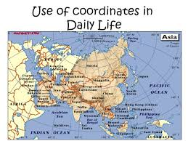

Slide 4
Coordinate geometry is applied to many professions and used by many in real life. For example in case of computer, programmers use coordinate geometry because most of the programs generate PDF files and in a PDF file, the printed page is one big coordinate plane.
It is thus used to position elements on the page. PDF files that are produced contain text, images and line drawings, all of which are placed into position by using (x,y) coordinates, distances, slopes, and simple trigonometry.
It is also applied in scanners which make use of coordinate geometry to reproduce the exact image of the selected picture in the computer. It manipulates the points of each information in the original documents and reproduces them in soft copy.

Slide 5
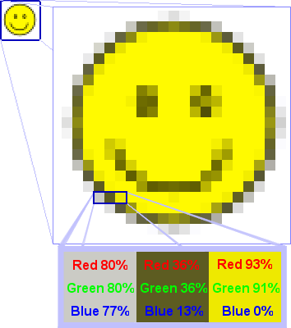
Coordinate geometry is also used in manipulating images. The selected image is like a big coordinate plane with each color information as each individual points. Thus when the colors of the pictures are being manipulated, the points are changed.

Slide 6
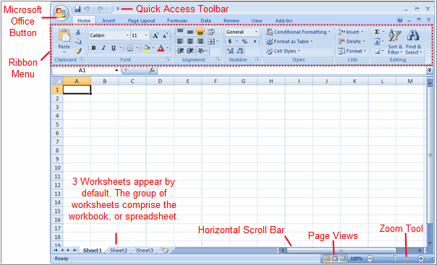
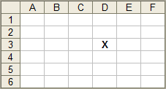
Cell Address is (D,3) or D3

Slide 7
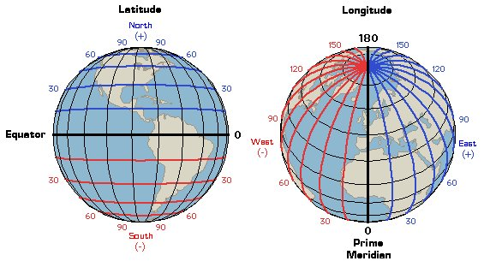

Slide 8
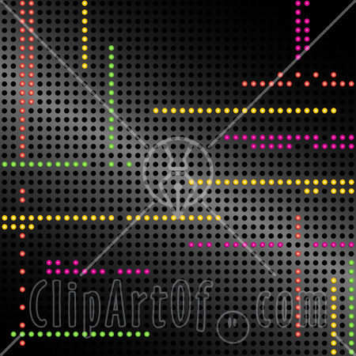
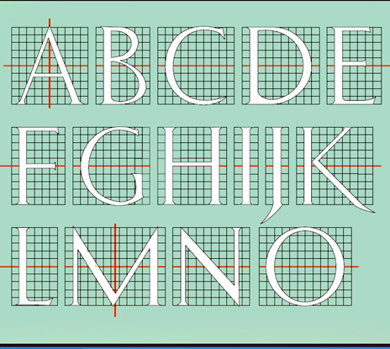
Lettering with Grid

Slide 9
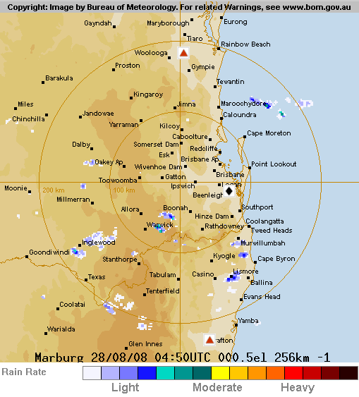
R
A
D
A
R
M
A
P

Slide 10
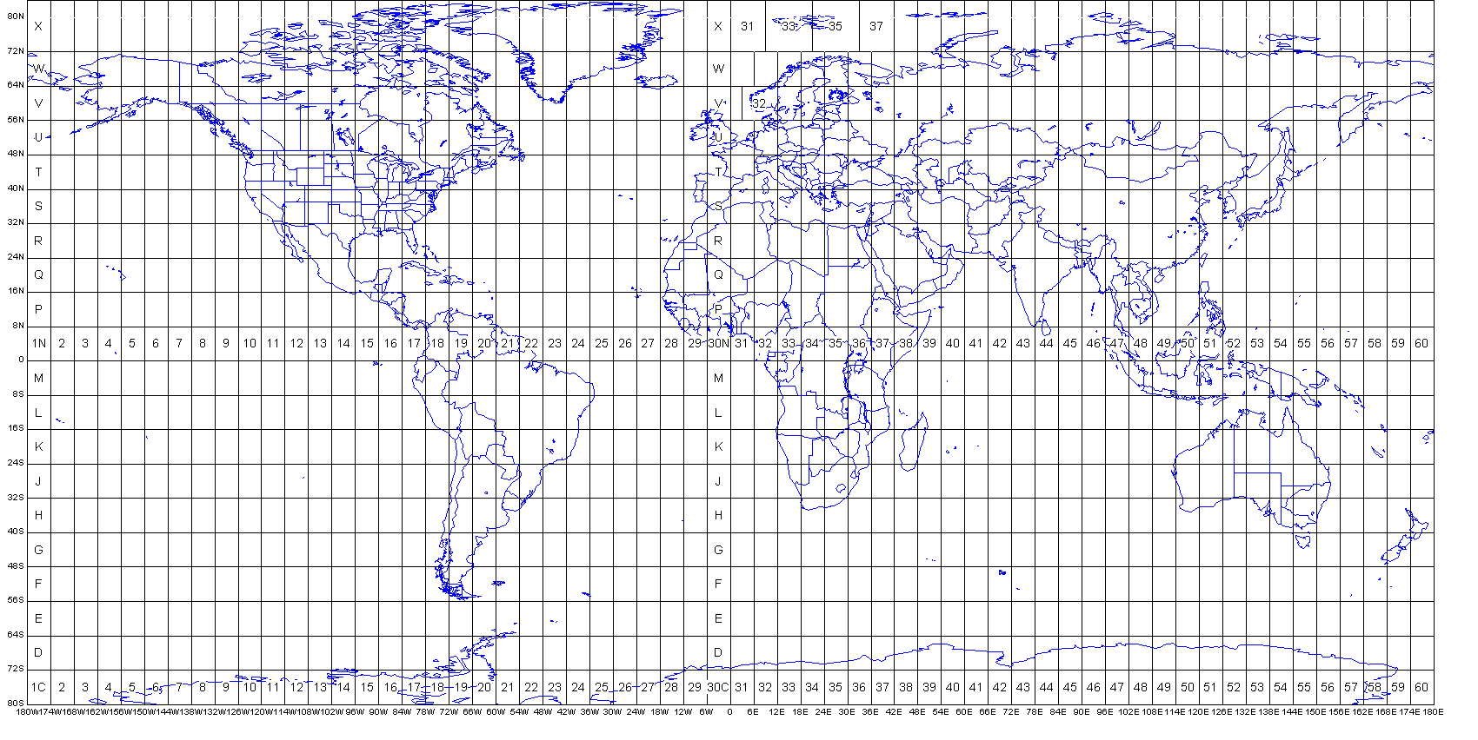
CONVERSION FROM 3D to 2D

Slide 11
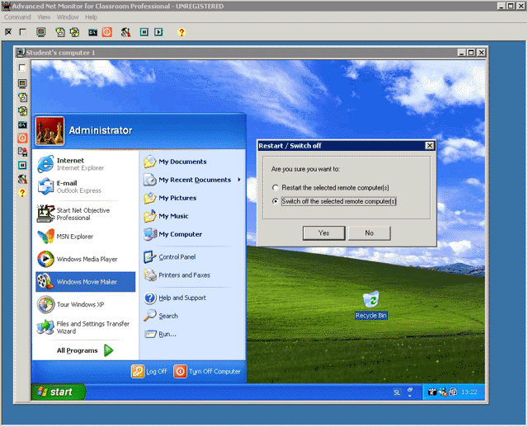
The screen you are looking at is a grid of thousands of tiny dots called pixels that together make up the image

Slide 12
BY
B.M CHAUBEY

